Slide 1
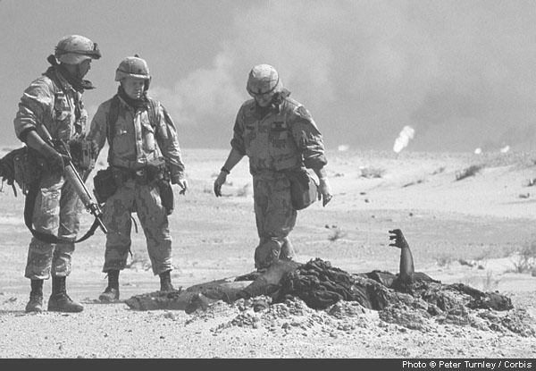
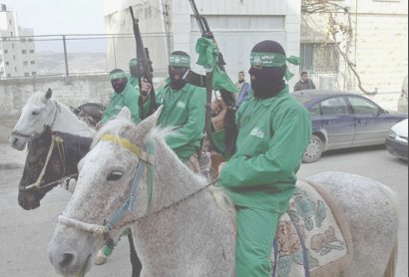
The First Gulf War and its aftermath
Matthew Payne
(First Gulf War, 2008)
(Hamas Revolt, 2008)

Slide 2
Outline
Thesis Statement- Slide 1(assume this slide is 0)
Gulf War- Slides 2-10
Terrorism in the 1990’s- Slides 11-13
State Sponsors of Terrorism- Slides 14- 18
Terrorism Organizations- Slides 19-22
Conclusion- Slide 23
Vocabulary- Slide 24
People- Slide 25
References- Slides 26-27

Slide 3
Thesis
Operation Desert Storm had its roots in the First Persian Gulf War (the Iran-Iraq war) in the 1980’s. In it, Iraq, defended against Iran’s Islamic extremism and was utterly decimated economically for its pains. The ultimate battle between secularism and religious extremism had been waged and left the secular side with a large debt and an even larger army. With no one left to fight besides its own people, the Iraqi army turned to Kuwait, an artificially created country with a great deal of Iraqi heritage. Saddam Hussein used this, as well as other excuses to invade and conquer the tiny country. After an international alliance of 35 different countries stepped in to repulse the Iraqi invasion, Iraq went from having the 4th largest army in the world to the second largest inside its own borders. But Operation Desert Storm did not finish off Hussein and overthrow his dictatorship. As a result of the power vacuum left by the dissolution of the USSR and the defeat of the Iraqi army, the Middle East was left with no great power and so began to fill up the void with many little powers. Most of these powers were comprised of anti West, anti Israel forces of both extreme Islam and secular political entities. Although this report does not mention the suppression of the Kurdish state or the political strife in places like Bosnia and Somalia, these events played a large role in the aftermath of the First Gulf War.

Slide 4
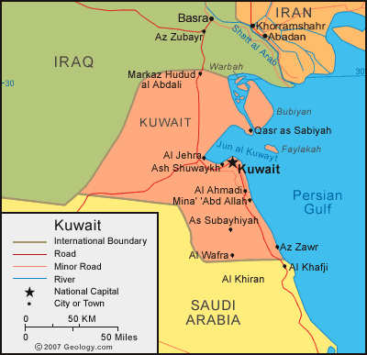
Causes of the Iraqi Invasion
Iran-Iraq war of the 1980’s devastated the Iraqi economy while leaving its vastly expanded military without any viable targets.
Iraq was a very outspoken proponent of OPEC oil regulation, since it relied heavily on those exports to sustain its economy.
Iraq claimed Kuwaiti lands as basically Iraqi. Only the artificially drawn borders were keeping the country from being the 19th province of Iraq. Saddam Hussein believed that it was similar to German reunification, which was widely supported as a dissolution of artificial borders
(Iraq Kuwait map, 2007)

Slide 5
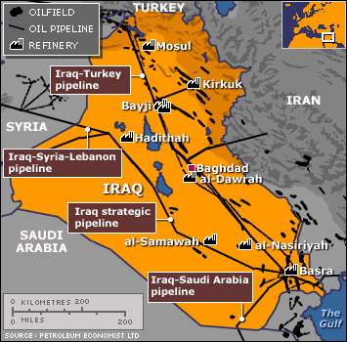
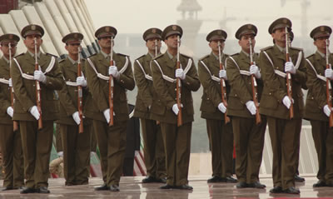
Additional Causes
Iraqi war debt load was incredibly high. Saddam Hussein said that because Iraq defended the rest of the Middle East from the Islamic extremist government of Iran and its powerhouse of a military, it deserved to have some of its war debts cancelled.
One of its largest, yet militarily weakest debtors was Kuwait. Kuwait held around 13 billion dollars in war debts and was unable to enforce its claims militarily.
Kuwait increased production and lowered their oil prices past OPEC levels and caused an economic depression in Iraq, which was unable to shift their production quickly enough to cope.
(Oil fields southern Iraq, 2008)
(Iraqi Military, 2008)

Slide 6
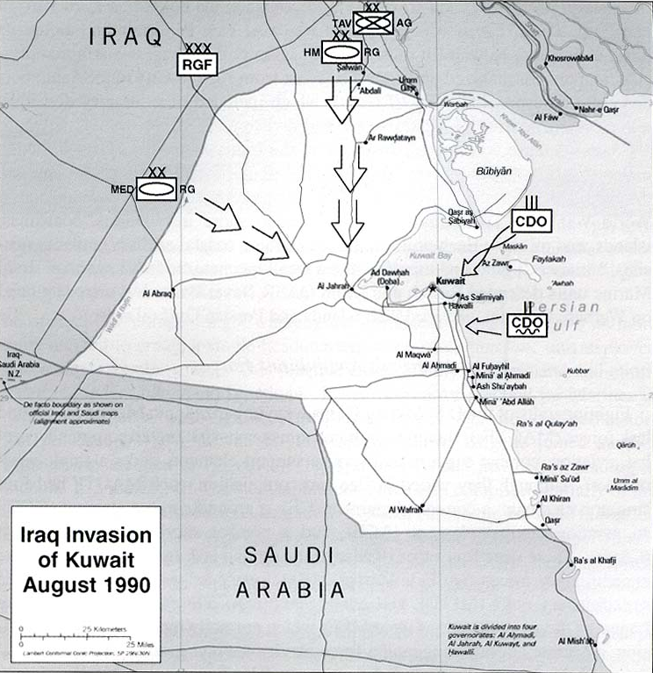
Iraqi Invasion and World Response
The Iraqi invasion of Kuwait was done before anyone was able to react and allowed Saddam to quickly gain control of the country.
The same day of the invasion, August 2nd, 1990 the UN Security Council agreed 14 to none with one abstaining on resolution 660.
The Resolution stated: UN Resolution 660
Within days of the Iraqi take over, American aircraft began to trickle into the Saudi Arabia as the world realized it to be the most likely subsequent target. On August 6th, UN Resolution 61 was enacted, placing stringent economic sanctions on Iraq for its actions.
On August 8th, Iraq officially annexes Kuwait as its 19th province.
Desert Shield, the purely defensive plan to ensure Saudi Arabia’s protection was begun. American military presence increased from the normal 200,000 servicemen to over 400,000.
Saddam offers to withdraw from Kuwait peacefully if Israel would withdraw from Palestine, Lebanon, and Syria.
(Kuwait Invasion, 2008)

Slide 7
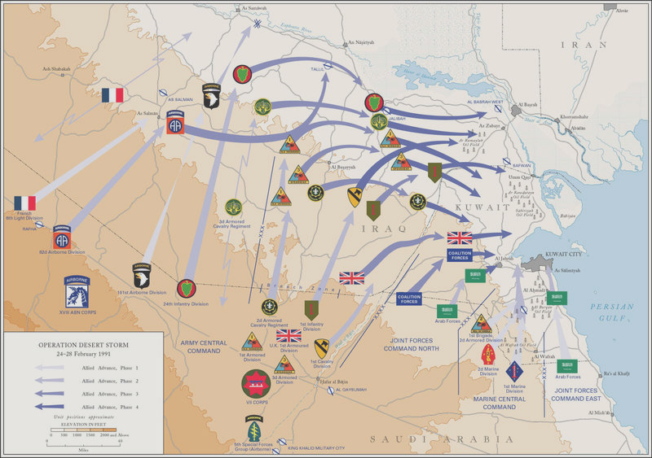
Preparation for Desert Storm
The UN voted for resolution 678 which “Authorizes Member States co-operating with the Government of Kuwait, unless Iraq on or before 15 January 1991 fully implements, as set forth in paragraph 1 above, the foregoing resolutions, to use all necessary means to uphold and implement resolution 660 (1990) and all subsequent relevant resolutions and to restore international peace and security in the area”
If Iraq had acted before October, many military analysts believe that the large army could have overwhelmed the troops gathered there with relative ease.
But instead, Saddam paused and allowed a coalition of 35 countries to gather in Saudi Arabia over the course of the next six months to organize for the war everyone knew was coming.
His fatal flaw was this brief hesitation
Saddam also lost the intensely fought media war, a war that Kuwait won through forgery and trickery.
(Desert Shield Map, 2008)

Slide 8
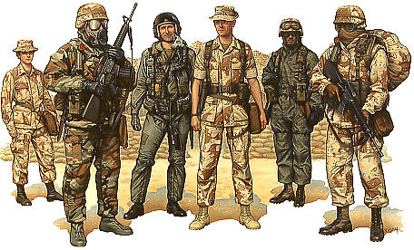
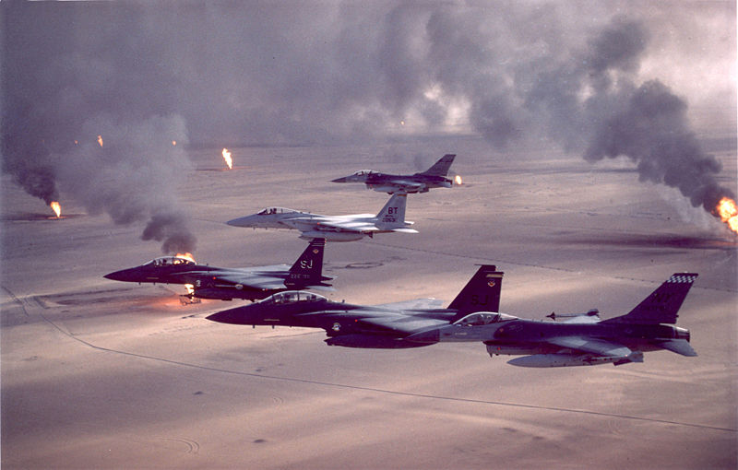
Operation Desert Storm
Needless to say, Saddam Hussein refused to remove his army from Kuwait by the end of January 15th.
So, Operation Desert Storm was kicked off at 0:30 the morning of January 16th.
Operation Desert Strom was run by General Schwarzkopf of the American military and consisted of a taskforce of close to 1 million servicemen and women from around the world.
The largest military presence there was the United States followed by Saudi Arabia in a distant second and Great Britain in an even more distant third. But the unilateral support given by the international community at large demonstrated the effectiveness of the UN at coordinating military matters when the U.S. backed it up.
(Desert Storm, 2008)
(Desert Storm, 2008)

Slide 9
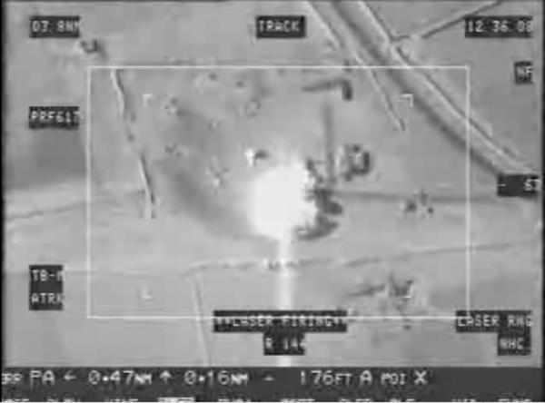
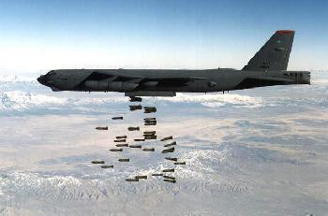
Aerial Phase
General Schwarzkopf sent in several United States Intelligence service members to cripple the Iraqi land based anti air capabilities with a computer virus several weeks before the January 15th deadline.
Cruise missiles and laser guided bombing runs devastated Iraqi targets across Kuwait and Iraq. The Iraqi army’s supply route and anti air defenses were soon wiped off the face of the earth under the intense allied bombing campaign.
Saddam was able to launch several SCUD missiles at Tel Aviv and Haifa before total aerial superiority was achieved.
For five weeks, the allies continued the aerial bombardment, effectively wiping out any chance of resistance.
(Laser Guided Bombs, 2008)
(B-52 Bomber, 2008)

Slide 10
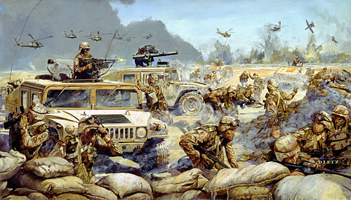
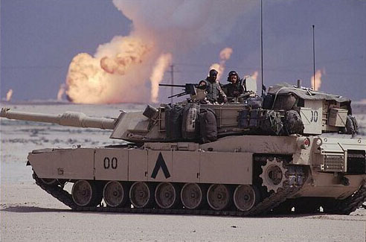
Ground Phase
A small Iraqi contingent consisting of a tank battalion and two infantry battalions crossed the Saudi-Kuwait border to capture the deserted town of Khafji. They held the town for almost two days until the coalition forces were able to overcome their position. As was typical of the war, there were high casualties on the Iraqi side and low casualties on the coalition side.
The ground phase, although some may argue that it was not, was mostly a mop up operation. The Iraqi army was shattered. The skies were owned by the coalition forces. When the ground phase kicked off on February 24th, resistance was minimal as the coalition forces flanked the Iraqi entrenchments.
Closely supported by the coalition’s air power, the ground forces moved quickly through Kuwait and retook it within 100 hours of the kickoff point.
(Desert Storm, 2008)
(Desert Storm, 2008)

Slide 11
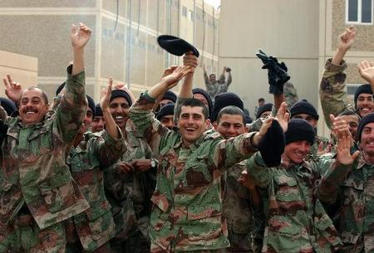
Desert Storm Ends
Saddam withdrew his troops after the brutalization through the only effective highway back to Iraq, through the Al Jahra' pass. This road became known as the “Highway of Death” as coalition bombers ground the troops retreating through that route into the dirt. The massacre that took place on the road was cause of much grief for the coalition’s Arabic nations as they felt it was not necessary to kill their brothers senselessly and completely.
George Bush declared an end to Desert Storm as soon as Iraqi troops had finished fighting in Kuwait on February 28th.
Many people criticized George Bush for his decision to not topple Saddam Hussein and restore the country to a more peaceful and pliable leader.
Secretary of Defense Dick Cheney stated that to rebuild Iraq would have been a “bad idea” and become a “quagmire” which the U.S. would not wish to get into.
Plus, some respect was still due to Iraq for providing a buffer between Iran and the rest of the Middle East.
(Celebrating Marines, 2008)

Slide 12
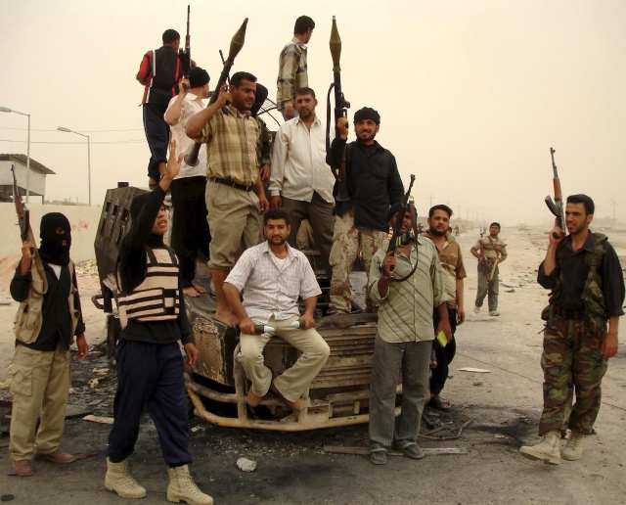
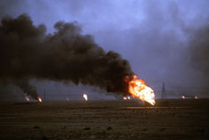
Immediate Aftermath
Huge ecological and economic damage was done to Kuwait as the militaries of the globe ravaged the land and resources they lived on. Over 600 oil pumps were set ablaze by Hussein’s retreating soldiers and the resulting oil spills and waste were difficult to resolve.
Iraq’s ability to do much of anything besides stagnate was removed through international treaty and practical reality. With the Iraqi army nearly wiped out of existence, various uprisings and civil unrest followed in the wake of the retreat.
These uprisings were barely repressed and Saddam barely controlled his own country.
The U.S. established a no fly zone over Iraq during most of the 1990’s.
(Baghdad Unrest, 2008)
(Desert Storm Oil, 2008)

Slide 13
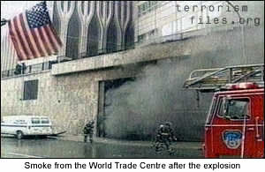
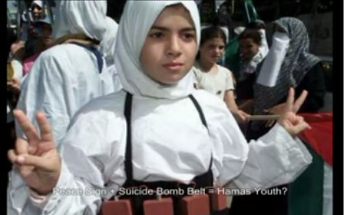
Terrorism in the 1990’s
After the Gulf Wars, and the fall of communism, a power vacuum emerged from the death of the old Soviet Union.
The 90’s were, for America, a mostly carefree, prosperous time. Private citizens enjoyed the wealth gleamed off of the dot com bubble and new, lower oil prices.
America was not ready for the unrest across the world however and was taken by surprise when the World Trade Centers were bombed in 1993.
The advent of the suicide bomber had been recently made practical through tactics pioneered by the Tamil Tigers in Sri Lanka.
The idea has been transferred to nations in civil revolt across the world.
The 1990’s saw an increase in the amount of religious terrorism.
(World Trade Center Bombing, 2008)
(Suicide Belt, 2008)

Slide 14
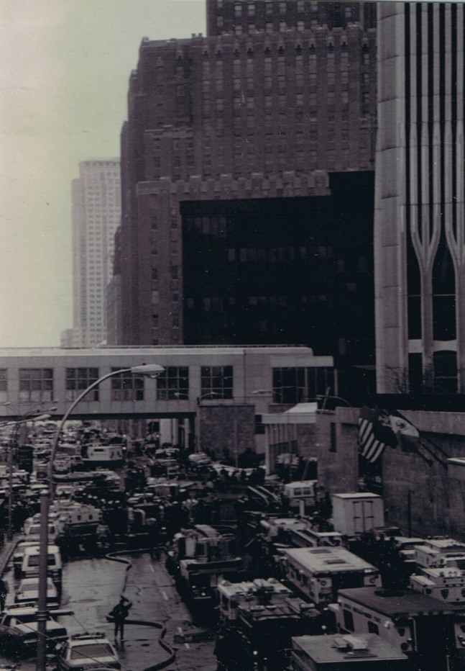
1993 World Trade Center Bombing
Ramzi Yusef began independently planning an attack upon the United States as a protest against U.S. support for Israel and intervention in the Middle East.
Yusef consulted his uncle, Mohammed Ali Fadden on the best tactics to use and was even wired some money to aid his plot.
On February 26th, 1993 he executed his plan and exploded a 1500 lb urea nitrate bomb in the garage below WTC 1.
His goal was to collapse WTC 1 on the second tower and cause massive casualties.
His attack was relatively unsuccessful and killed only 6 people
This attack was an indicator of a growing trend. The continuing turmoil in the Middle East due to the power vacuum left by the collapse of both the Soviet Union and Iraq left many countries with radicalized populations as Iran’s message of extremism purveyed the now empty airwaves.
(Wikimedia)

Slide 15
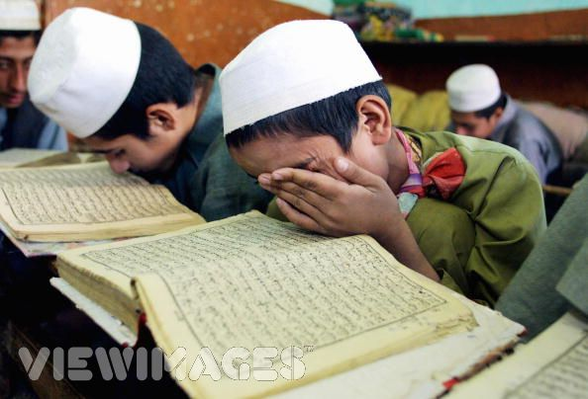
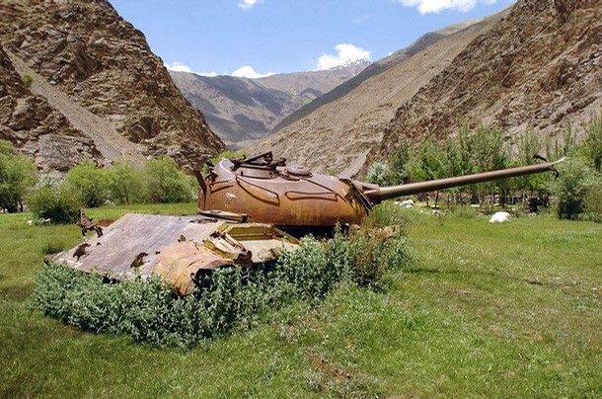
Extremist Group Appeals
The people of the Middle East began to turn against their long time exploiter and “protector”, the United States. Popular resentment grew as Israel was allowed to continue to exist and thrive, and Western nations continued to exploit the resources in the region. The U.S. continued to send vast quantities of money to various states such as Saudi Arabia who was known to directly sponsor terrorist organizations.
The long time war between Afghanistan and the USSR had toppled the superpower but left the CIA trained and funded Islamic extremist group Al Qaeda in power. When the USSR no longer harassed their borders, they focused their speeches of intolerance towards Israel and the United States.
As the power of local extremist groups grew throughout the Islamic world, country after country fell into line against the U.S.
Local extremist groups offered the people not only a belief and a set of hatreds which unified people against a common foe, but also took the time and money to improve local society.
Al Qaeda provided security for the common man and groups like the Muslim Brotherhood in Egypt educated inner city youth and pledged to fight for the people.
Many people found that the local militia provided much better protection and education for them and their families than the corrupt government ever did.
(Islamic school, 2008)
(Broken Soviet tank, 2008)

Slide 16
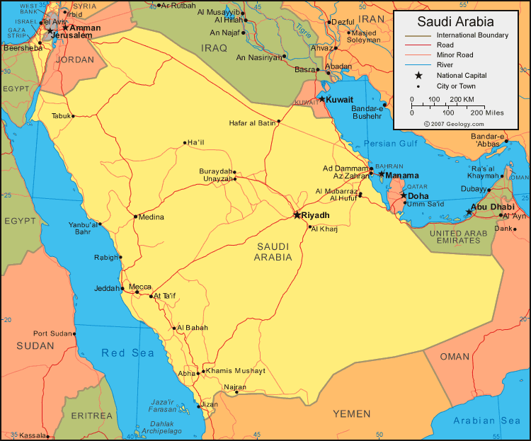
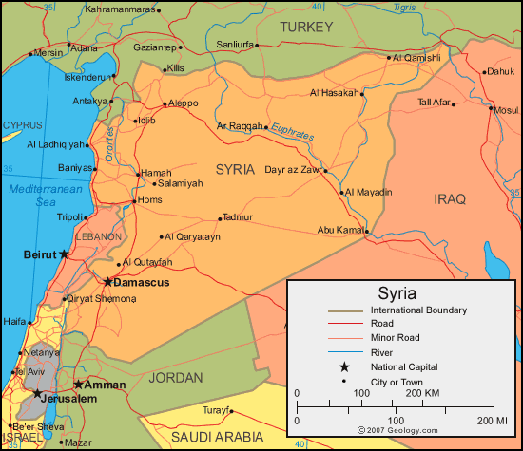
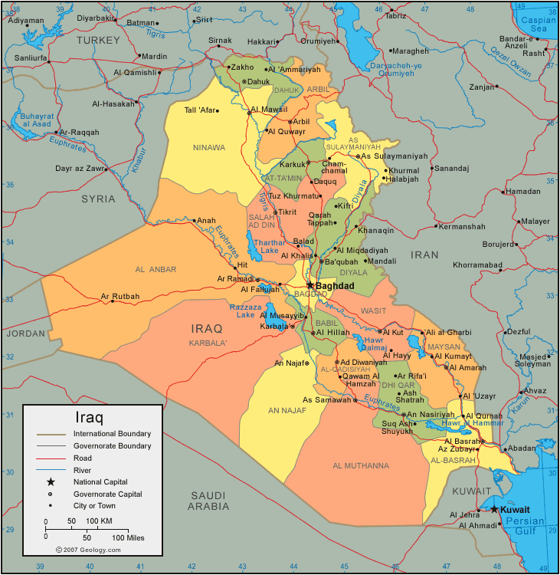
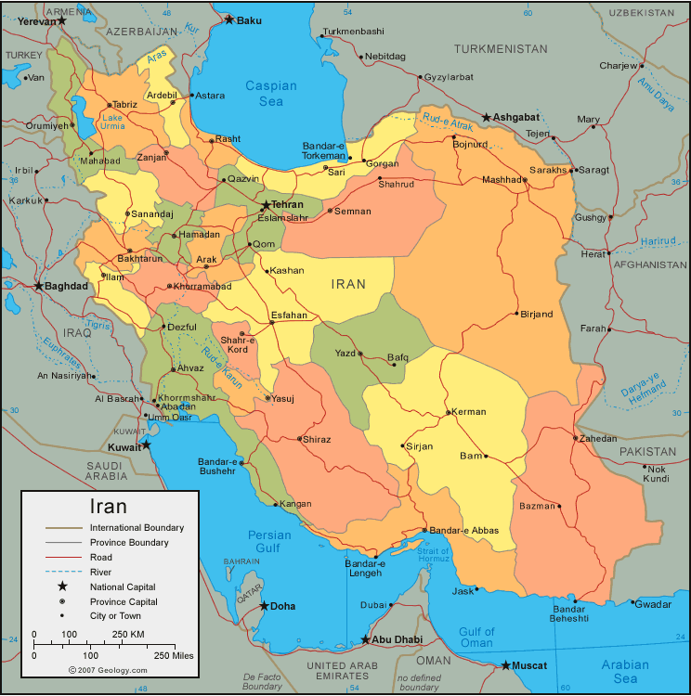
State Sponsors of Terror
While not all of the states mentioned here are able to be directly held for their sponsorship, it has been revealed that they are all at least partly involved in the sponsorship of terrorist organizations worldwide.
Saudi Arabia
Iraq
Iran
Syria
(Syria, 2008)
(Saudi Arabia, 2008)
(Iraq, 2008)
(Iran, 2008)

Slide 17
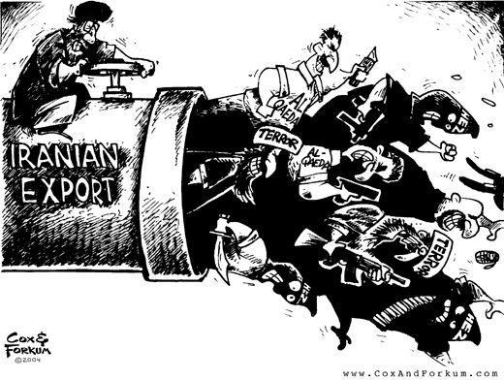
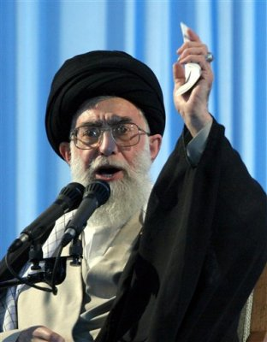
Iran
Iran has been one of the leading sponsors of terrorism since 1979 and its Islamic Revolution. Supreme Leader Ayatollah Khomeini is one of the founding fathers of modern day Islamic extremism and has been trying to export his message of radicalism since the beginning.
Iran is a major supporter of numerous terrorist organizations throughout the world and has actually founded several major cells
Hezbollah was founded by Iran in 1980 and continues to this day to be heavily supported by the oil rich nation.
Hamas, Palestinian Liberation Front, and several other anti- Israeli/ anti- American organizations are all supported directly by the state.
(Iranian terrorism, 2008)
(Ayatollah, 2008)

Slide 18

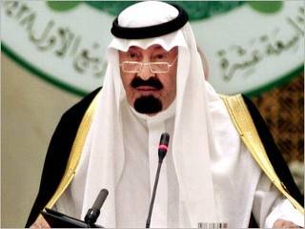
Saudi Arabia
Saudi Arabia has been a long time friend of the United States due to the extensive foreign aid and military support that country has received in exchange for their continued friendship. Operations Desert Shield and Storm were conceived to protect the Saudi nation from Iraqi incursion.
But, in recent years, it has been discovered that the funds the United States has been supplying Saudi Arabia with have come back to hurt American interests. Through various unregulated and mostly government sponsored charities. When the 9/11 commission looked into this fact, they discovered that many of the sponsored charities were in fact supporting Al Qaeda in turn. Although an investigation revealed that no government officials were directly involved in the donation of funds to terrorist organizations, the U.S. was still afraid of Saudi support. So, the U.S. forced the Saudi government to pass legislation regulating the sponsors and flow of cash through their country.
Even so, the commission concluded that, “the Kingdom of Saudi Arabia has an uneven record in the fight against terrorism” . King Fahd vehemently denied any claims that his government directly supported terrorist organizations.
During the 1990’s Saudi Arabia became a prime fund raising area for terrorist organizations and a large amount of the funds came from U.S. interests.
(9/11 Commission, 2008)
(Saudi terrorism, 2008)

Slide 19
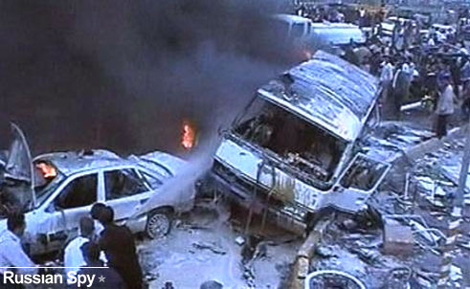

Iraq
Iraq was devastated after the First Gulf War. Economic sanctions did not allow it to sell oil until 1996, and even then in very limited quantities.
The agricultural sector was going through a huge slump due to mismanagement and drought. Thus, Iraq became increasingly dependent on imports to sustain its population. These imports led to a vast national deficit and general poverty throughout the country.
Out of the ashes of the old military, Saddam Hussein continued to bide his time and refocus his power. He continued to kidnap, torture, and kill anyone he pleased; using terrorist tactics to control his country.
Saddam Hussein was a direct sponsor for groups like Hamas, Abu Nidal’s mercenaries, and several smaller, mostly secular terrorist organizations who worked against his regional enemies.
As opposed to common belief it is highly unlikely that Saddam Hussein aided Al Qaeda directly.
(Iraqi Terrorism, 2008)
(Saddam Hussein, 2008)

Slide 20
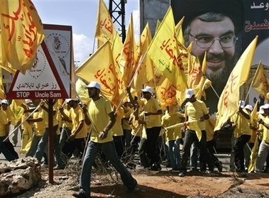
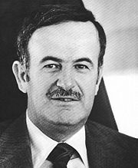
Syria
Syria maintains its status as a secular dictatorship. As such, it is a state sponsor of internal terrorist organizations and has been on the State Department’s list of countries sponsoring terrorism since its inception in 1979.
Although the export of terrorism is no longer directly supported by the Syrian government, it does not halt the flow of arms and individuals across its borders and thus provides easy access for other countries to use.
Syria offers Hezbollah both political and organizational aid and provides a safe haven for the terrorist organization.
Hafez-Al-Assad provided a rule over Syria which was criticized by much of the world for its human rights abuses.
(Hezbollah, 2008)
(Hafez Al Assad, 2008)

Slide 21
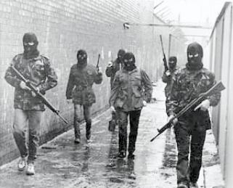
Overview of Terrorist Organizations
A few major terrorist organizations which emerged as great powers during the post Desert Storm world were:
Hezbollah
Al Qaeda
Hamas
(Terrorism, 2008)

Slide 22
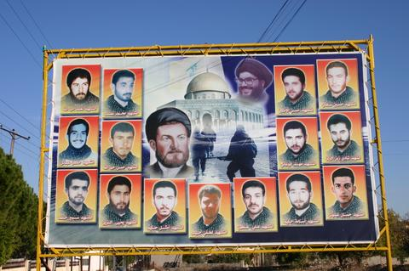
Hezbollah
Hezbollah was formed in 1980 by Iran in an attempt to create an anti Israeli militia to “eradicate Western colonialism” and bring to justice those responsible for the atrocities during the Lebanese Civil War
The world opinion on the organization varies around the globe; some countries recognizing it as a legitimate resistance movement and others as a terrorist organization
During the 1990’s Hezbollah continued to push for Israeli departure from southern Lebanon and ran similar goals as the Palestinian Liberation Front
Sayyed Hassan Nasrallah was and is the secretary general of the organization since 1992 and continues to fight against Israeli expansion and promotes anti-Israeli messages.
Hezbollah is attributed some of the first suicide bombing tactics used by Islamic resistance groups. But, it soon became more than just a simple destructive militia.
Hezbollah was transformed into a socio-political group of anti-Israeli pro Palestine, pro Lebanon paramilitary organization.
Hezbollah claimed that it would only fight to defend itself and would not make any aggressive actions towards Israel.
Hezbollah has also become more tolerant of other religions in face of the multi ethnic nation that is Lebanon.
(Wikimedia)

Slide 23
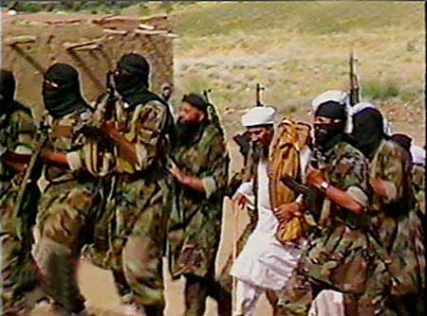
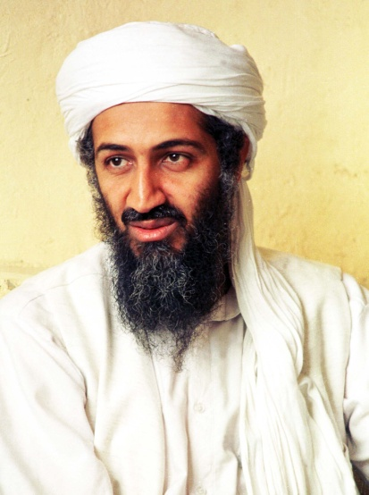
Al Qaeda
Al Qaeda is probably the most widely known terrorist organization known in America today.
In the 1990’s the organization, founded by radical leader Abdullah Yusuf Azzam had grown and strengthened following the collapse of the Soviet Union.
Al Qaeda began as a small militia among many in Afghanistan, vying for power among the numerous warlords. During that time, America would support anyone willing to resist the USSR and so helped train and supply Al Qaeda and ensure its dominance. The CIA sent numerous advisors in to Afghanistan to train the insurgents with American military hardware.
The tactic proved highly efficient and the USSR was soon ensconced in the quagmire of Afghanistan. US aid money began pouring into Al Qaeda (among various other resistance groups) coffers. The defeat of the Soviet Union is largely attributed to these efforts and the policy was considered a huge success.
But, once the enemy in the north was defeated, the organization’s new leader, a young Saudi outcast by the name of Osama Bin Laden turned his attention to the enemy in the West. As Afghanistan was reorganized under Al Qaeda rule, Bin Laden bided his time and planned various attacks on the United States.
Al Qaeda provided many of the same positive benefits as other Islamic extremist organizations; security, education, improvements, etc. So, ignoring the various terror tactics they used to maintain power, Al Qaeda was accepted as the effective rulers of Afghanistan for most of the decade
(Al Qaeda, 2008)
(Osama Bin Laden, 2008)

Slide 24

Hamas
Founded by Sheik Ahmed Yassin Hamas is a militant organization which is openly anti-Israeli. It was formed as an offshoot of the Egyptian Muslim Brotherhood and is a legitimate political party in the Palestinian Authority council.
Its charter basically states the wish to eradicate Israel and reform the Palestinian state where Israel currently resides.
The group has been known for its heavy reliance upon suicide bombings and, once again, social welfare and education programs.
Many Palestinians identify with the party’s objectives and there is widespread popular support in several countries for the organization.
(Wikimedia)

Slide 25
Conclusion
The political atmosphere of the Middle East changed drastically during the aftermath of Operation Desert Storm. Various organizations attempted to fill the gaps left by the disappearance of the areas primary military powers. The power vacuum gave rise to an all new wave of both religious extremism on one end, and corrupt secularism on the other.

Slide 26
Vocabulary*
SCUD missile- A SCUD missile is a fairly low tech short range missile originally designed by the Soviet Union. IT is used mostly in developing nations to extend the reach of psychological warfare.
Patriot Missile System- A weapons system conceived in the 80’s and disproved in the 90’s, the concept was designed to counter SCUD missiles. A Patriot Missile Battery would shoot several smaller, faster, missiles to destroy an incoming SCUD. It turned out to not work so well.
Biological Weapons- A biological weapon is any delivery system of an infectious disease, whether bacterial or viral purposefully released in a target area. Their main problem is control.
Suicide Bomber- A suicide bomber is an individual who either straps a bomb to themselves or rigged to a vehicle and uses their own body as a weapon to strike either civilian or military targets. In both cases, the bombing is done for maximum casualties and maximum psychological effect.
Slant Drilling- Slant drilling is the process by which an oil drilling entity bores a hole into the ground at an angle verging from the vertical or horizontal.
No Fly Zone- A no fly zone is an area of airspace whose total lack of air traffic is a result of military enforcement.
Secular- Secular is any section of society which is non religious.
OPEC- OPEC stands for Organization of the Petroleum Exporting Countries. They are a conglomeration of international business oriented countries who set global oil prices and production levels.
UN Security Council- The UN Security Council is composed of five permanent members: China, United States, United Kingdom, Russia/Soviet Union, and France (effectively, the “winners” of World War II). Each of the five permanent members has a veto and a majority must be reached to conclude anything. Every two years, ten additional members are elected to compose the rest of the Security Council.
Tamil Tigers- Rebels in Sri Lanka, they oppose the national government. They were the pioneers of the suicide bombing technique when used in civil unrest.
*- Definitions created by Matthew Payne

Slide 27
Important Names
Michael Gorbachev- The final General Secretary of the Communist party in Russia, he is largely responsible for the dissolution of the USSR and the end of the Communist state in Russia
Yahya Ayyash- Important engineer who progressed the technology and techniques of the suicide bomber significantly.
Sheik Ahmed Yassin- Founder of Hamas in 1987
Osama Bin Laden- Successor to the leadership of Al Qaeda, he leads the party to dominance in post Soviet Afghanistan.
Saddam Hussein- The secular dictator of Iraq, he follows a policy of torture, kidnapping, and murder to maintain control of his country most of the time. He was able to successfully hold off Iran after his rise to power in 1983. he is a state sponsor of secular terrorism across the world.
George H. Bush- The President of the United States of America from 1988- 1992, he initiates Operation Desert Shield and Storm. He constantly battles Congress over the presidential powers and uses the UN to circumvent Congress in Desert Storm
Colin Powell- Head of the Joint Chiefs of Staff under George Bush, he advises the President on the situation in the Middle East and makes several personal trips to Saudi Arabia with Secretary of Defense Dick Cheney to investigate personally the situation there.
General Schwarzkopf- Leader of the U.S. led coalition forces in Desert Shield and Storm, he decimates the Iraqi army and is able to quickly and efficiently liberate Kuwait with minimal coalition casualties.
Supreme Leader Ayatollah Khomeini- Leader of the Islamic Republic of Iran, he organized and executed the revolution of 1979 against the U.S. backed Shah of Iran. His interpretation of Islam is considered incredibly radical and has been exported out of Iran to various countries around the globe.
Sayyed Hassan Nasrallab- Secretary General of Hezbollah since 1992, he leads the party and military.
Ramzi Yusef- Coordinator of the 1993 bombing of the World Trade Center.

Slide 28
References
(2004, January, 26). Semper Fi, Mohammed?. The Happy Carpenter, Retrieved May 20, 2008, from http://happycarpenter.blogs.com/the_happy_carpenter/2004/01/semper_fi_mohom.html
(2006). IRA Guerilla Tactics. Retrieved May 20, 2008, from IRA Terrorism Web site: http://geology.com/world/saudi-arabia-satellite-image.shtml
(2006, November, 24). Russia Condemns Baghdad Terrorist Attack. Russian Spy, Retrieved May 20, 2008, from http://www.russianspy.org/?s=kamynin
(2006, September, 21). Will Nasrallah show up at Hezbollah 'victory' rally?. Lebanon News, Retrieved May 20, 2008, from http://yalibnan.com/site/archives/2006/09/will_nasrallah.php
(2007, June 8). Hamas. Retrieved May 20, 2008, from Council on Foreign Relations Web site: http://www.cfr.org/publication/8968/
(2007, March 10). Greetings from the Religion of Peace. Retrieved May 20, 2008, from DCnet's Islamist Watch Web site: http://islamistwatch.wordpress.com/2007/03/10/greetings-from-the-religion-of-peace/
(2007, May 9). History of the Department of Veterans Affairs. Retrieved May 20, 2008, from Public and Intergovernmental Affairs Web site: http://www1.va.gov/opa/feature/history/history8.asp
(2007, November 30). Biodiesel Summit. Retrieved May 20, 2008, from Cambridge Forecast Group Blog Web site: http://cambridgeforecast.wordpress.com/2007/11/
(2008, April 21). Kuwait Maps. Retrieved May 20, 2008, from University of Texas Libraries Web site: http://www.lib.utexas.edu/maps/kuwait.html
(2008, April 28). Photo from Getty Images. Retrieved May 19, 2008, from Daylife Web site: http://www.daylife.com/photo/0cWHfvfbSJaye
(2008, March, 27). Babylon and Beyond-IRAQ: 85 minutes of war. Los Angeles Time, Retrieved May 20, 2008, from http://latimesblogs.latimes.com/babylonbeyond/baghdad/
1993 World Trade Center Bombing. Retrieved May 20, 2008, from Wikipedia Web site: http://en.wikipedia.org/wiki/Image:1993_World_Trade_Center_Bombing_by_Eric_Ascalon_WTC5.jpg
Bajoria, J (2008, April 18). al-Qaeda. Retrieved May 20, 2008, from Council on Foreign Relations Web site: http://www.cfr.org/publication/9126/
Beckner, C (2006, December 8). Getting Right with the 9/11 Commish. Retrieved May 20, 2008, from Military.com-DefenseTech.org Web site: http://www.defensetech.org/archives/003048.html

Slide 29
References
Bronstein, P Islamic School. Retrieved May 20, 2008, from JAMD Web site: http://www.jamd.com/search?assettype=g&assetid=1167437&text=Islamic+school
Clemons, S (2007). July 2007 Archives. Retrieved May 20, 2008, from The Washington Note Web site: http://www.thewashingtonnote.com/archives/2007/07/
Dietz, J (2008, April 28). The Lightning of Desert Storm. Retrieved May 20, 2008, from Vladimir Arts Web site: http://www.vladimirarts.com/store/comersus_viewItem.asp?idProduct=85
Eshel, D (2008, April 21). Traumatic Future looming over Iraq. Retrieved May 20, 2008, from Defense Update Web site: http://www.defense-update.com/newscast/0107/analysis/analysis-120107.htm
F (2004, July 19). Iranian Export. Retrieved May 20, 2008, from Cox and Fokum Web site: http://www.coxandforkum.com/archives/000377.html
Fletcher, H (2008, February). Syria. Retrieved May 20, 2008, from Council on Foreign Relations Web site: http://www.cfr.org/publication/9368/
Friedman, H (2000). The Strategic Bomber and American Psyop. Falling Leaf, Journal of the Psychological Warfare Society, Retrieved May 20, 2008, from http://www.psywarrior.com/B52leaflets.html
Grinter, L (1983). Avoiding the Burden. Air University Review, Retrieved May 20, 2008, from http://www.airpower.maxwell.af.mil/airchronicles/aureview/1983/jan-feb/grinter.html
Gulf War. Retrieved May 19, 2008, from Gulf War Info Web site: http://www.cryan.com/war/
Hafez al-Assad. Retrieved May 20, 2008, from e ciencia Web site: http://www.e-ciencia.com/recursos/enciclopedia/Hafez_al-Assad
Haywood, B (2006, November, 13). Not everyone shares death wish. Fairfax Digital, Retrieved May 20, 2008, from http://www.theage.com.au/news/education-news/not-everyone-shares-death-wish/2006/11/10/1162661903428.html
Hot Winter Cold-Blood. Sex, Drugs, & Third-Wheel Politics, Retrieved May 20, 2008, from http://citizenj.wordpress.com/2007/03/02/hot-winter-cold-blood/
Iraq Survey Group Final Report. Global Security.org, Retrieved May 18, 2008, from http://www.globalsecurity.org/wmd/library/report/2004/isg-final-report/isg-final-report_vol1_rfp-anx-d.htm
Ismail, N. H. (2007, January, 8). Al Qaeda’s Southeast Asia, Jamaah Islamiyah and Regional Terrorism:. Japan Focus, Retrieved May 20, 2008, from http://japanfocus.org/products/details/2318
Israeli History- Desert Storm. Retrieved May 20, 2008, from Israeli Weapons Web site: http://www.israeli-weapons.com/history/desert_storm/Desert_Storm.html
Karim, A (2008, March, 27). Individual Terrorists: Ramzi Yousef. terrorism.org, Retrieved May 20, 2008, from http://www.terrorismfiles.org/individuals/ramzi_yousef.html
Kjeilen, T Gulf War. In Looklex Encyclopedia [Web]. LookLex Ltd.. Retrieved May 18, 2008, from http://lexicorient.com/e.o/gulfwar.htm
Kjellman, K (2007, October, 29). U.K. Soft on Terrorism? Saudi King Says So in BBC Interview. ABC News, Retrieved May 20, 2008, from http://blogs.abcnews.com/theblotter/2007/10/uk-soft-on-terr.html
Krupa, M (1997). Environmental and Economic Repercussions of the Persian Gulf War on Kuwait. ICE Case Studies, 9, Retrieved May 19th, 2008, from http://www.american.edu/TED/ice/kuwait.htm
Operation Desert Storm. Retrieved May 20, 2008, from Wikipedia Web site: http://commons.wikimedia.org/wiki/Image:Operation_Desert_Storm.jpg
Satellite images of Saudi Arabia. Retrieved May 20, 2008, from Geology.com Web site: http://geology.com/world/saudi-arabia-satellite-image.shtml
Uniform Plates. Retrieved May 20, 2008, from Permanent Marine Corps Uniform Board Web site: http://www.marcorsyscom.usmc.mil/sites/mcub/PAGES/uniform_plates.htm
USAF F-16A F-15C F-15E Desert Storm . Retrieved May 20, 2008, from Wikipedia Web site: http://commons.wikimedia.org/wiki/I

Slide 30
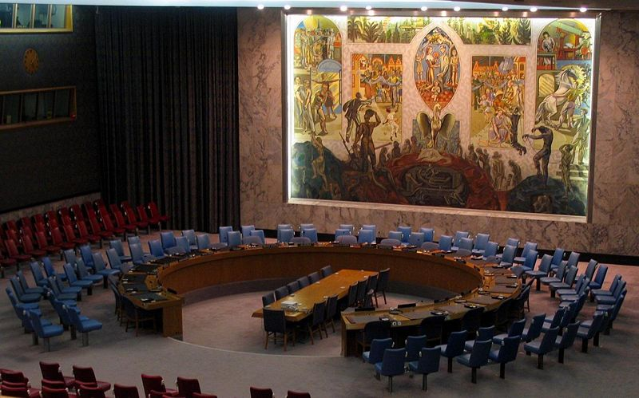
UN Resolution 660
The Security Council,
Alarmed by the invasion of Kuwait on 2 August 1990 by the military forces of Iraq,
Determining that there exists a breach of international peace and security as regards the Iraqi invasion of Kuwait,
Acting under Articles 39 and 40 of the Charter of the United Nations,
1. Condemns the Iraqi invasion of Kuwait;
2. Demands that Iraq withdraw immediately and unconditionally all its forces to the positions in which they were located on 1 Augusst 1990;
3. Calls upon Iraq and Kuwait to begin immediately intensive negotiations for the resolution of their differences and supports all efforts in this regard, and especially those of the League of Arab States.
4. Decides to meet again as necessary to consider further steps to ensure compliance with the present resolution.
Back
(UN Security Council, 2008)

